Slide 1
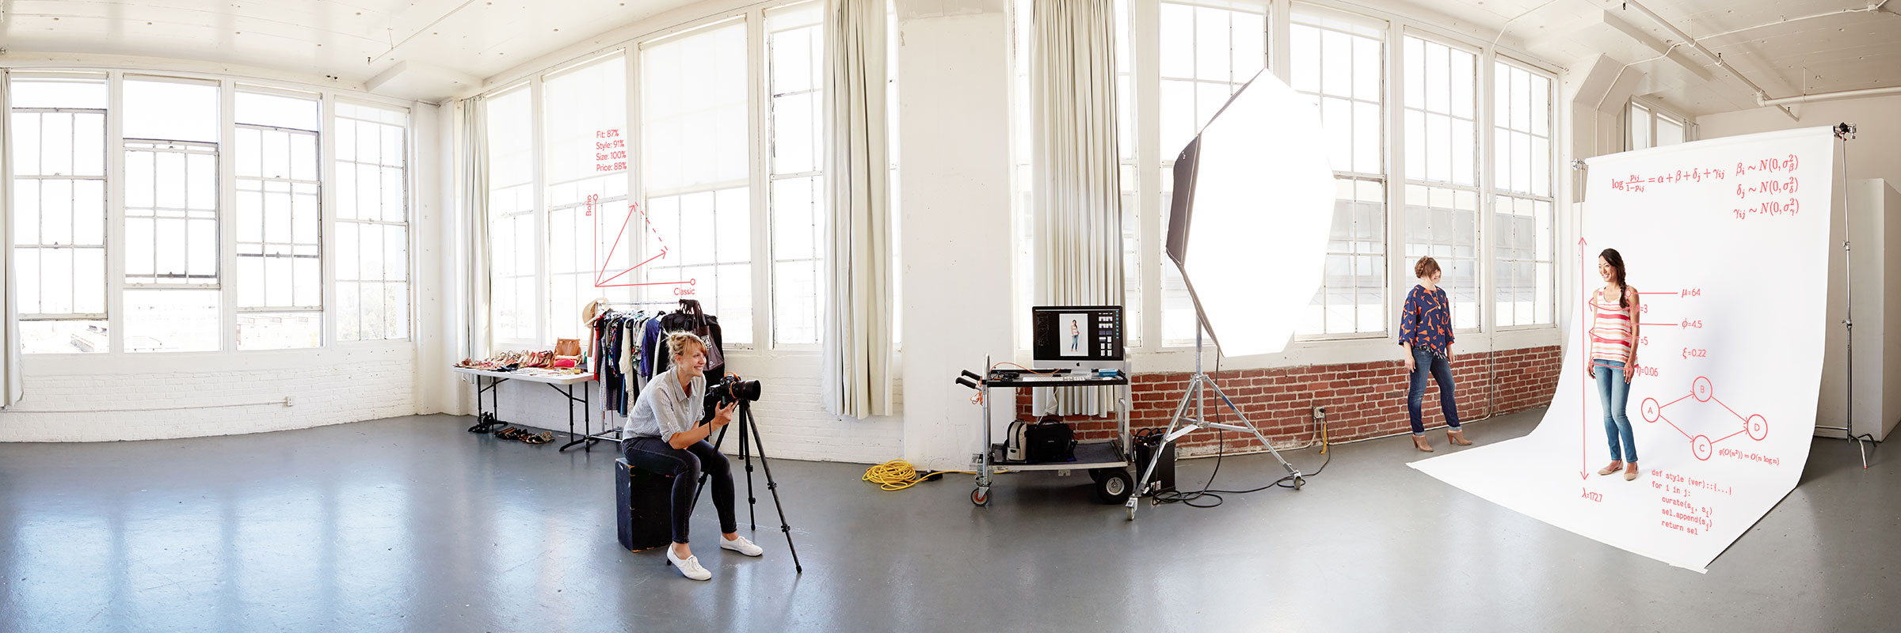
styling algorithms 101
cx training | march 2, 2016
contact (we want to hear from you!)
deep ganguli : dganguli@stitchfix.com
brad klingenberg: brad@stitchfix.com
eric colson: ecolson@stitchfix.com

Slide 2
















































the algorithms organization
Client Algorithms
Styling Algorithms
Merchandise Algorithms
kim
john
jas
charlotte
brad
deep
kyle
aaron
xian
paolo
daragh
greg
dave
joerg
tara
alex
zack
kelty
Jay m
patrick
Jay w
jasmine
cian
Nick k
Zhou
erin
hoda
kenna
alan
tatsiana
sven
Tim s
katherine
andy
kevin
doug
Data Platform
Data Labs
jmag
bhaskar
richie
alex
diana
akshay
eli
chris
Tarek
tj
Brian
jerome
jacob

Slide 3
the plan
your styling algorithms team
how the styling algorithm works
the future of algorithms
questions during encouraged!

Slide 4
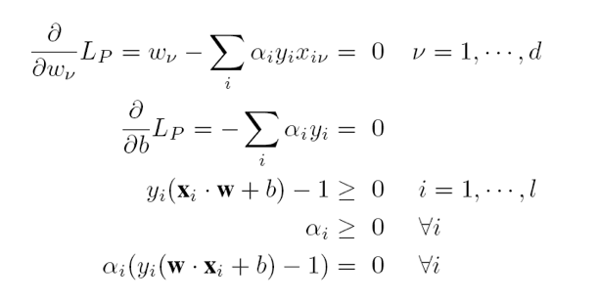
what does styling algorithms do?
1. styling algorithms

Slide 5
what does styling algorithms do?
1. styling algorithms
2. smart fix assignments

Slide 6



what does styling algorithms do?
1. styling algorithms
2. smart fix assignments
3. stats and analyses

Slide 7







your styling algorithms team
brad
Minx Algo Dev
Tools & Research
Stylist Analytics & Enablement
Human Comp
jay m
kyle
tatsiana
deep
Jay w
aaron
Tim s
jasmine
kelty
xian
katherine
patrick

Slide 8
the plan
your styling algorithms team
how the styling algorithm works
the future of algorithms

Slide 9
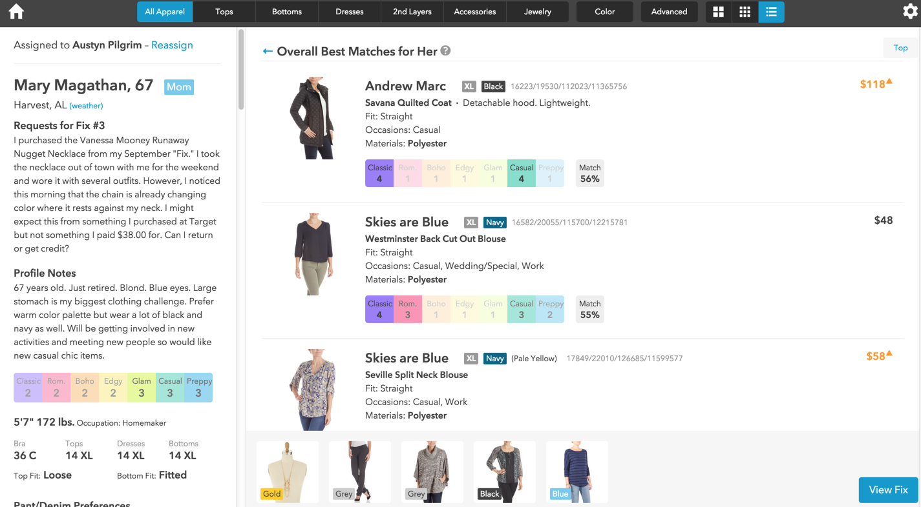

Slide 11

how are match scores computed?
argyle
version 9.0 of the styling algorithm
launched 09/2015

Slide 12
how are match scores computed?
overall item success rate
1
success rate based on age and size
match
score
2
success rate based on “sometimes” factors
3

Slide 13
how are match scores computed?
overall item success rate
number of times item was purchased
1
=
X 100
number of times item was sent

Slide 14
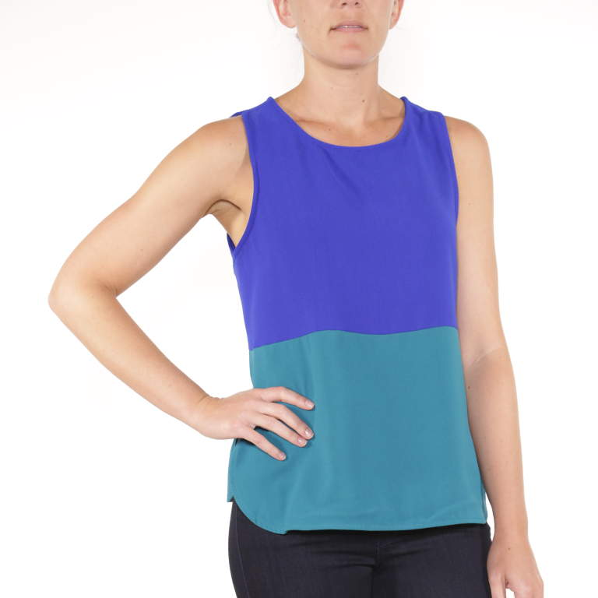
how are match scores computed?
overall item success rate
number of times item was purchased
1
=
X 100
number of times item was sent
day 1
0 / 0 = ???

Slide 15
how are match scores computed?
overall item success rate
number of times item was purchased
1
=
X 100
number of times item was sent
day 1
day 2
0 / 0 = ???
10 / 10 = 100%

Slide 16
how are match scores computed?
overall item success rate
number of times item was purchased
1
=
X 100
number of times item was sent
day 1
day 2
day 20
0 / 0 = ???
10 / 10 = 100%
450 / 1000 = 45%

Slide 17
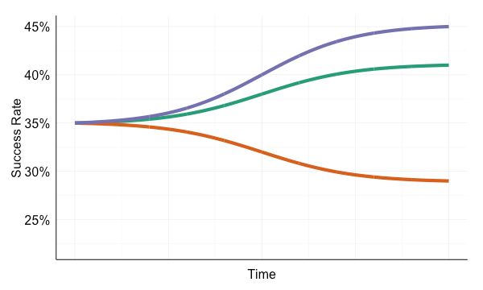
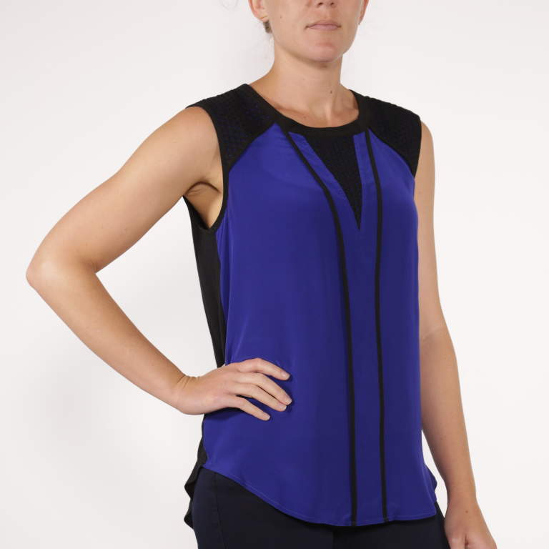
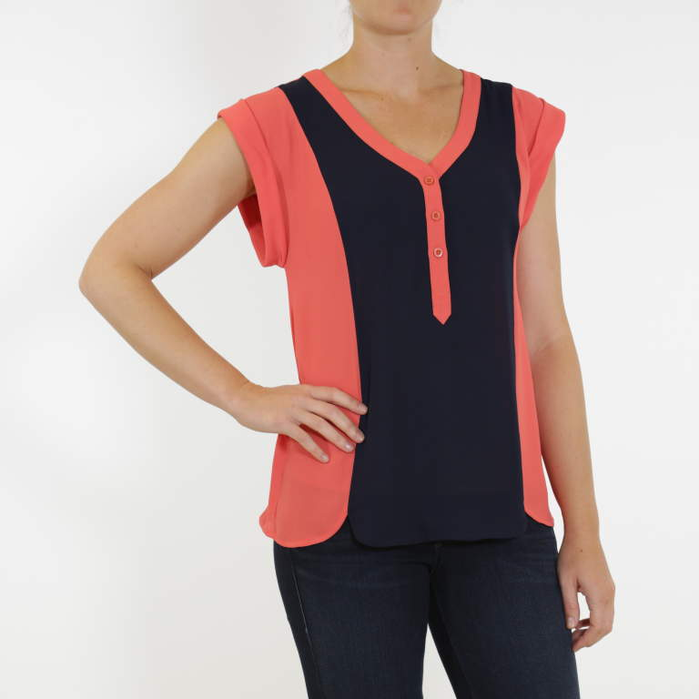
how are match scores computed?

Slide 18
how are match scores computed?
overall item success rate
1
success rate based on age and size
match
score
2
success rate based on “sometimes” factors
3

Slide 19
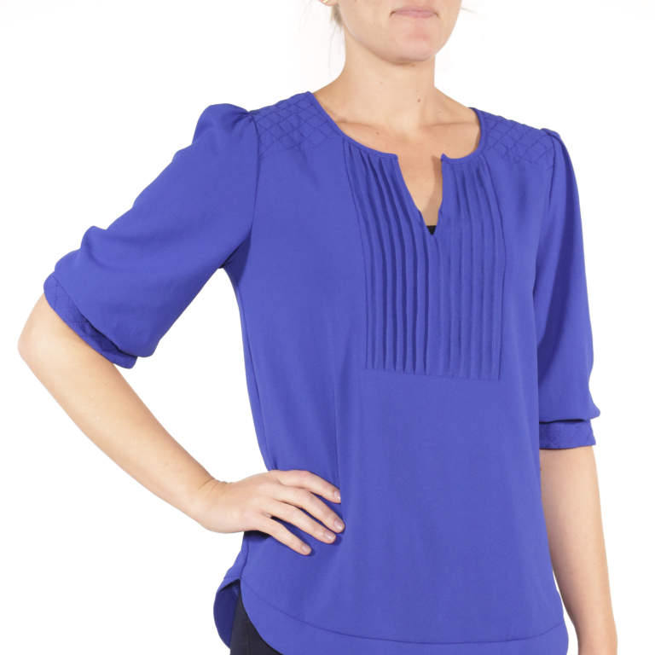
angela’s story
angela quilted blouse by 41 hawthorn
success rate of this item varies wildly with a client’s age and size

Slide 20
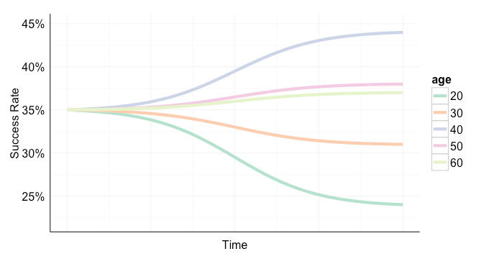
angela’s story, chapter 1: age

Slide 21
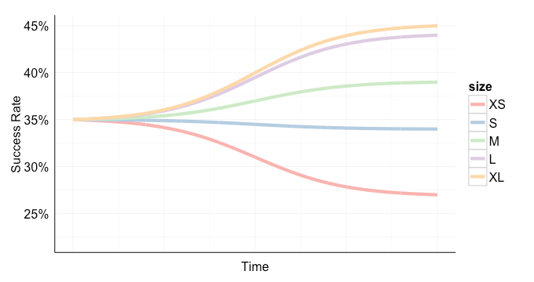
angela’s story, chapter 2: size

Slide 22
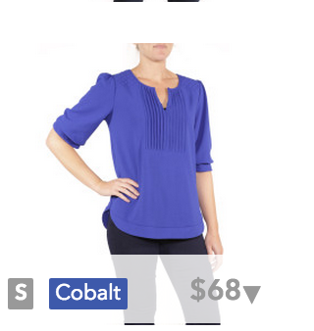
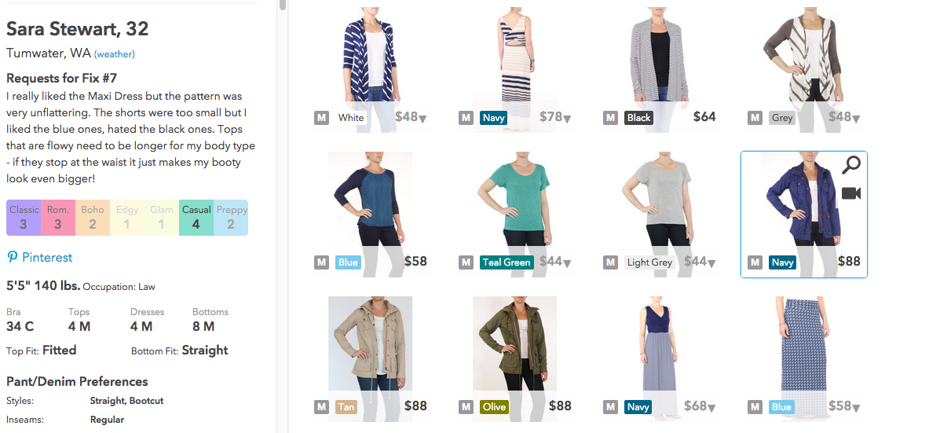


Slide 23
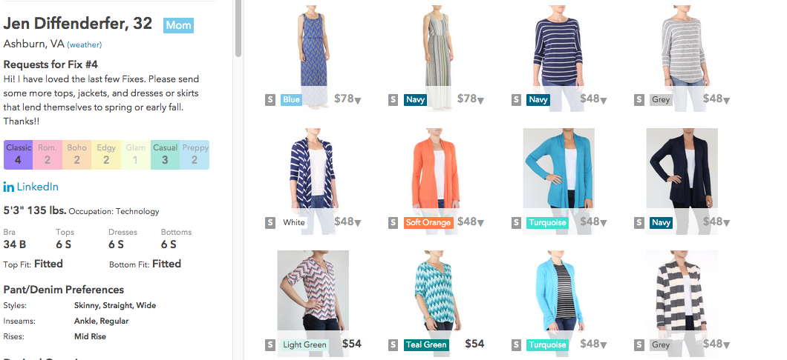

Slide 24
how are match scores computed?
overall item success rate
1
success rate based on age and size
match
score
2
success rate based on “sometimes” factors
3

Slide 25
argyle
always considers:
overall success rate
age
size
sometimes considers:
fit, e.g., tight or loose tops
height
price sensitivity

Slide 26
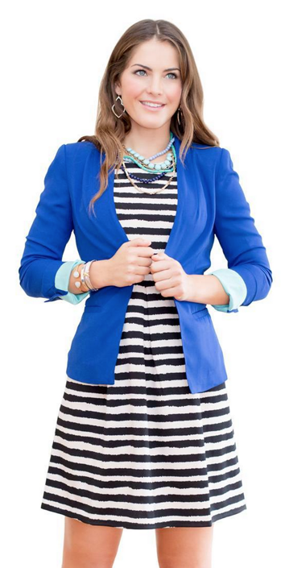
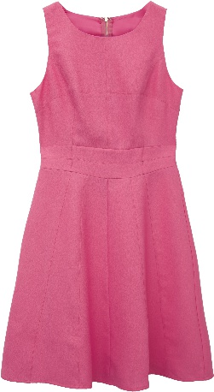
price sensitivity
price
spending pref for dresses

Slide 27
price sensitivity
price
spending pref for dresses
price match

Slide 28
what doesn’t argyle consider?

Slide 29
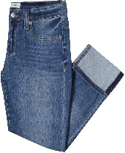
what doesn’t argyle consider?

Slide 30
what doesn’t argyle consider?
inseam

Slide 31
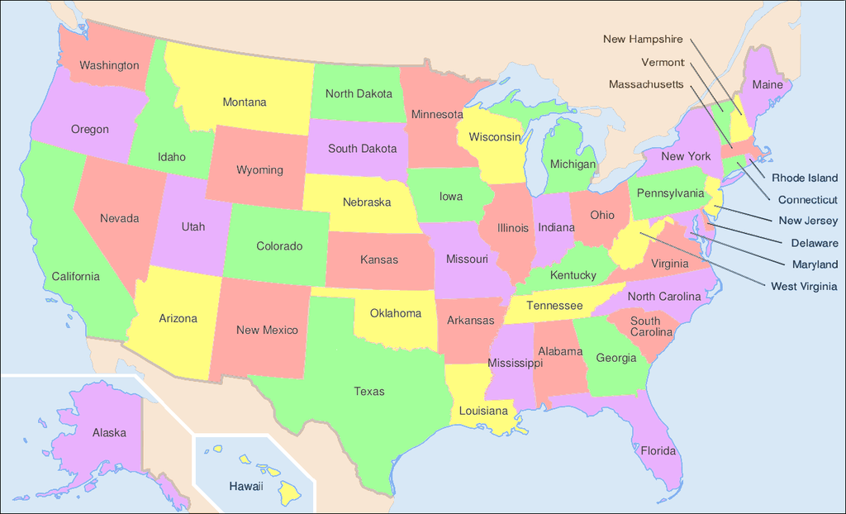
what doesn’t argyle consider?
inseam

Slide 32
what doesn’t argyle consider?
inseam
location

Slide 33

what doesn’t argyle consider?
inseam
location

Slide 34
what doesn’t argyle consider?
inseam
location
client history

Slide 35
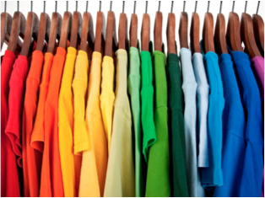
what doesn’t argyle consider?
inseam
location
client history

Slide 36
what doesn’t argyle consider?
inseam
location
client history
color

Slide 37
what doesn’t argyle consider?
inseam
location
client history
color
I am interested in a cute pair of stylish but casual shorts, also light colored jeans like you showed in the stich fix picture with the Justine Split Neck Top also would be great.

Slide 38
what doesn’t argyle consider?
inseam
location
client history
color
request note
I am interested in a cute pair of stylish but casual shorts, also light colored jeans like you showed in the stich fix picture with the Justine Split Neck Top also would be great.

Slide 39

the algorithm is not perfect
stylists should always exercise independent judgement
the algorithm learns from stylist selections!

Slide 40
measuring success
match score: 0.36

Slide 41
measuring success
1
0.6
match score: 0.36
actual proportion purchased
0.4
0.2
0
0
0.2
0.4
0.6
1
match score

Slide 42
measuring success
1
0.6
match score: 0.36
actual proportion purchased
0.4
0.2
0
0
0.2
0.4
0.6
1
match score

Slide 43
measuring success
1
0.6
match score: 0.36
actual proportion purchased
0.4
0.2
0
0
0.2
0.4
0.6
1
match score

Slide 44
measuring success
1
0.6
match score: 0.36
actual proportion purchased
0.4
0.2
0
0
0.2
0.4
0.6
1
match score

Slide 45
improving the scores
evidence based improvement
A/B testing

Slide 46

improving the scores
evidence based improvement
new data and algorithms
A/B testing

Slide 47

improving the scores
evidence based improvement
new data and algorithms
growing team
A/B testing

Slide 48
how does it all work?
A/B testing
service
SFA 2.0
(get me a fix!)
algorithms service
(xanadu)
minx
thriller
(gateway service)
client features service
RBM service
(mixer)
style features service
business time
algorithm time

Slide 49
what can go wrong?
if a client or a style is missing data, then a score cannot be computed
if this occurs persistently,
escalate to your lead
?
match score: -1
?
match score: -1

Slide 50


Slide 51
the plan
your styling algorithms team
how the styling algorithm works
the future of algorithms

Slide 52
row based minx
what:
a paradigm shift in how minx works.
a partnership between
styling, engineering, and data platform
why:
to offer more and better recommendations to serve our clients

Slide 53
row based minx goals
provide deeper personalization for clients
“nailed my style”

Slide 54
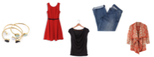
row based minx goals
provide deeper personalization for clients
increase variety in recommendations
“nailed my style”
suggested fix

Slide 55
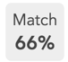
row based minx goals
provide deeper personalization for clients
increase variety in recommendations
increase transparency to stylists
“nailed my style”
suggested fix
ok, but why?

Slide 56
row based minx goals
provide deeper personalization for clients
increase variety in recommendations
increase transparency to stylists
enable more innovation
“nailed my style”
suggested fix
ok, but why?
why this order?
why this number?

Slide 57
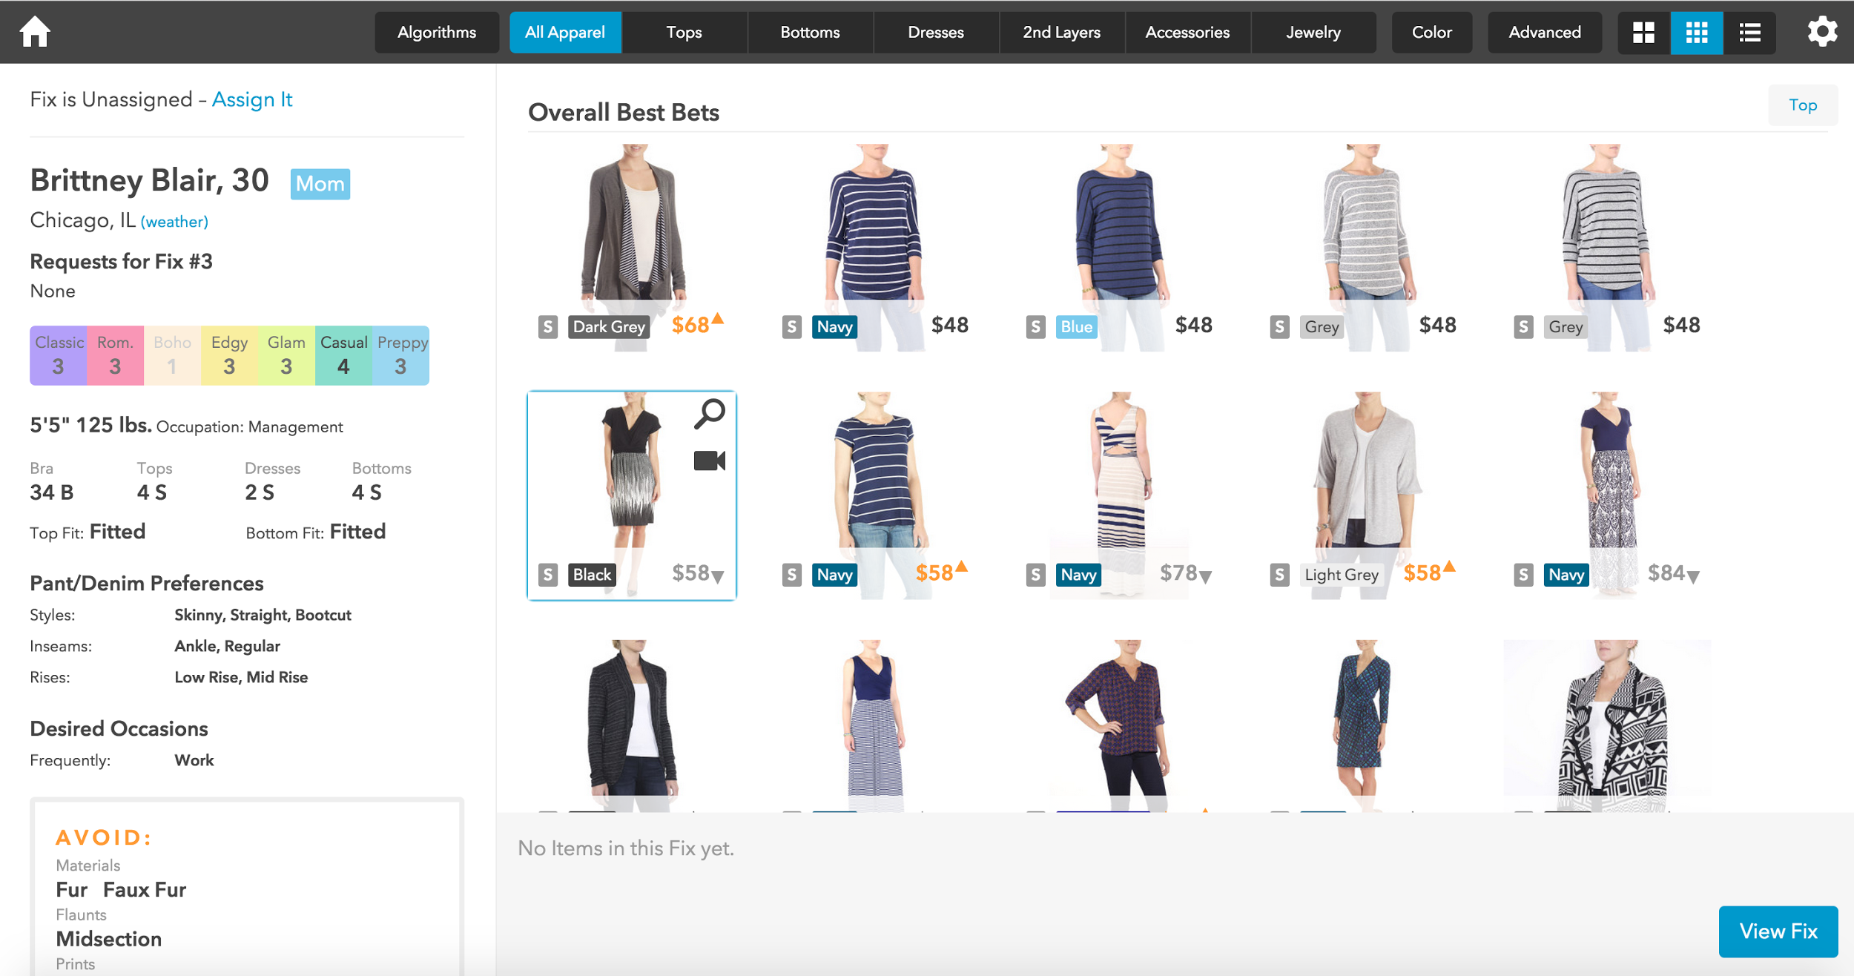
Notes:
As you are likely all aware, this is what Minx, our styling cockpit, looks like today. Stylists have access to information about the client on their left, three possible views of items in the center of the screen, and access to a variety of filters at the top of the page. Now, I’d like to show you the current RBM prototype.

Slide 58
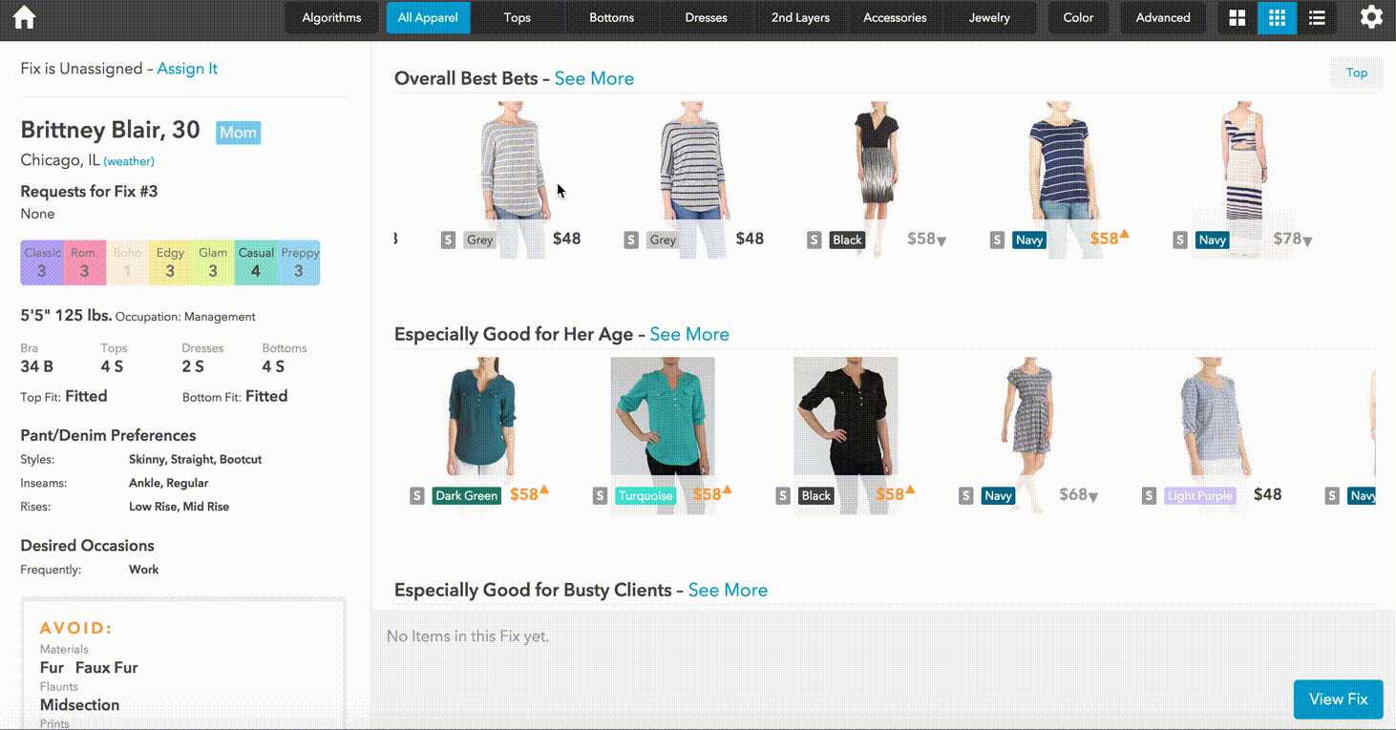
Notes:
As you can see, we have many of the same Minx features. What’s new is stylists will have access to a variety of “rows” to pick items from. In my RBM screen capture, you’ll see an “Overall Best Bets” row, which is equivalent to what stylists currently see in Minx. Below that there will be several other kinds of rows, some of which I’d like to share with you here. When styling different clients, different rows may show up as appropriate.

Slide 59
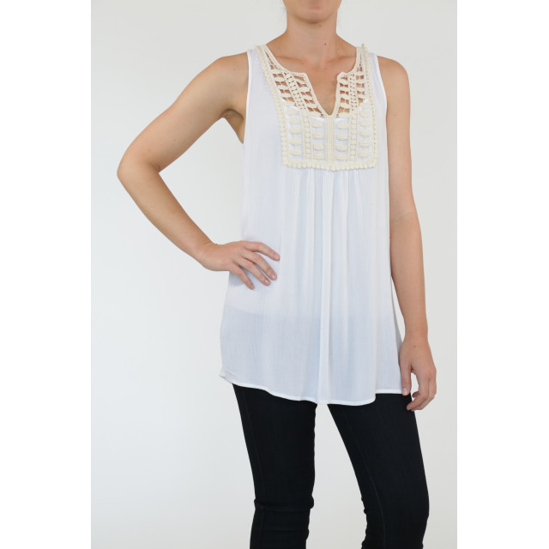
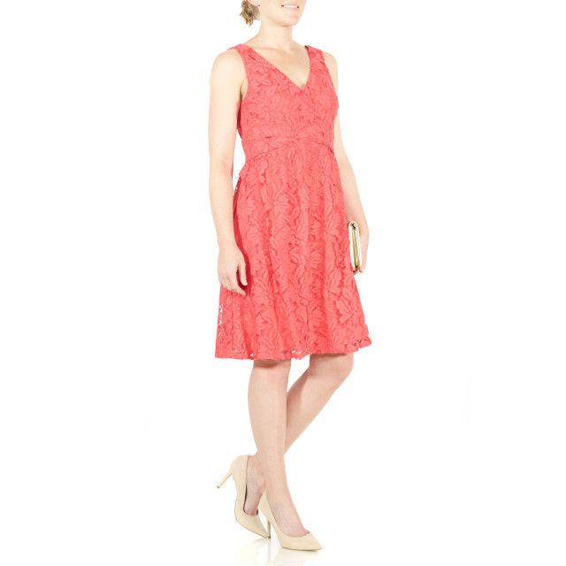
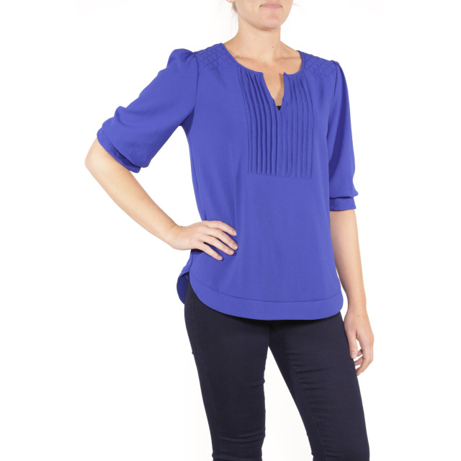
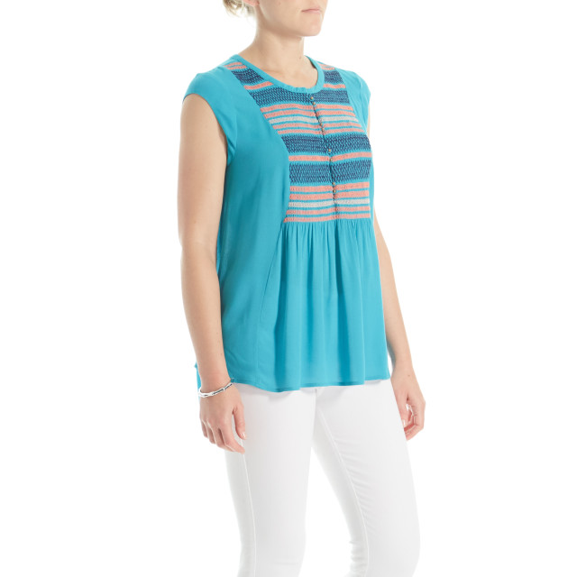
“Good For” ______
“Good For” age
“Good For” height
“Good For” maternity
“Good For” edgy
“good for” busty
items that do best with particular groups of clients
Notes:
One broad class of rows will be “Good For” rows. These will be populated by items that do particularly well for a specific group of clients. Examples could be items that do well for clients of a specific age, or height. Items that do well for maternity clients, or clients who are edgy. As an example, if I had a busty client, I might use a good for busty row.

Slide 60
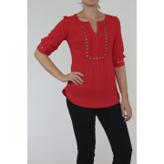
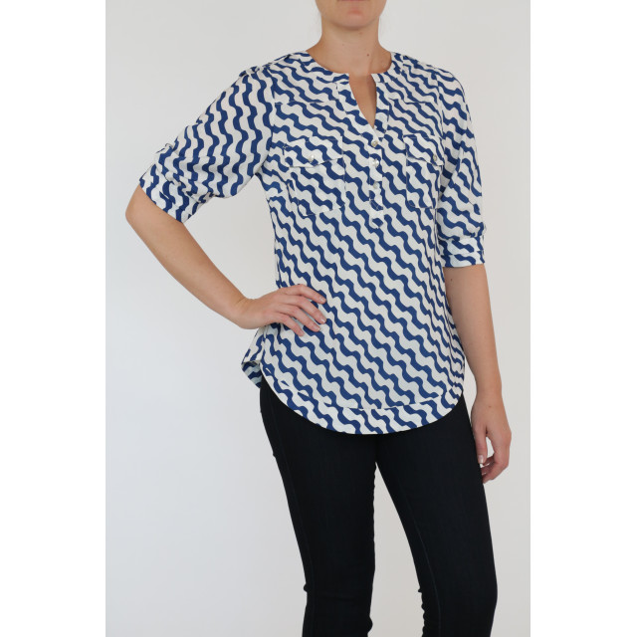
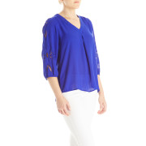
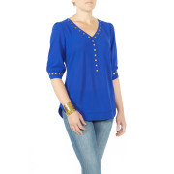
Clients that bought
this item also bought these items
Clients that liked the style of
this item also liked these items
Clients that liked the size of
this item also liked these items
clients that liked the fit of
this item also liked these items
“classic” recommendation engine, e.g. amazon
Notes:
Another class of rows will use so called “collaborative filtering” methods. You’ve probably seen when using Amazon - think “client’s that bought this item also bought these items”. For example, if my client previously bought the Moni, I might want to know what other clients who bought the Moni have purchased. I don’t have to stop there. I might be interested in clients who loved the style of the Moni, or the size. As an example, if I have a client who loved the fit of the Moni, I might choose from a collaborative filtering row with the following items.

Slide 61
let’s do a live demo
http://xanadu.vertigo.stitchfix.com/algo/rbm.gf_edgy_score_inferred/row/edgy_score_inferred4
http://xanadu.vertigo.stitchfix.com/algo/rbm.gf_preppy_score_inferred/row/preppy_score_inferred4
http://xanadu.vertigo.stitchfix.com/algo/test.pcf_relative_risk_lower_bound_sold_styleid/row/10038
http://xanadu.vertigo.stitchfix.com/algo/rbm.lda_styles_purchased/row/10038
http://xanadu.vertigo.stitchfix.com/algo/test.alexnet_fc7_euclid/row/10038
http://xanadu.vertigo.stitchfix.com/algo/test.styleid2vec/row/10038

Slide 62
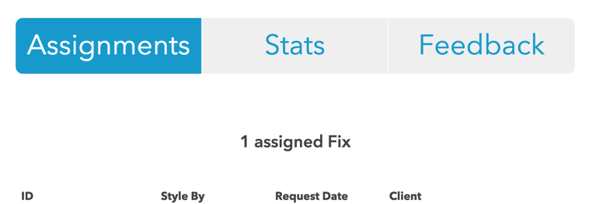
smart fix assignments 1.0

Slide 63

smart fix experiments
A / B
how should a fix be assigned?
stylist lives in austin
client lives
in austin
stylist does not live in austin

Slide 64

fulfilling request notes
I am interested in a cute pair of stylish but casual shorts, also light colored jeans like you showed in the stich fix picture with the Justine Split Neck Top also would be great.

Slide 65
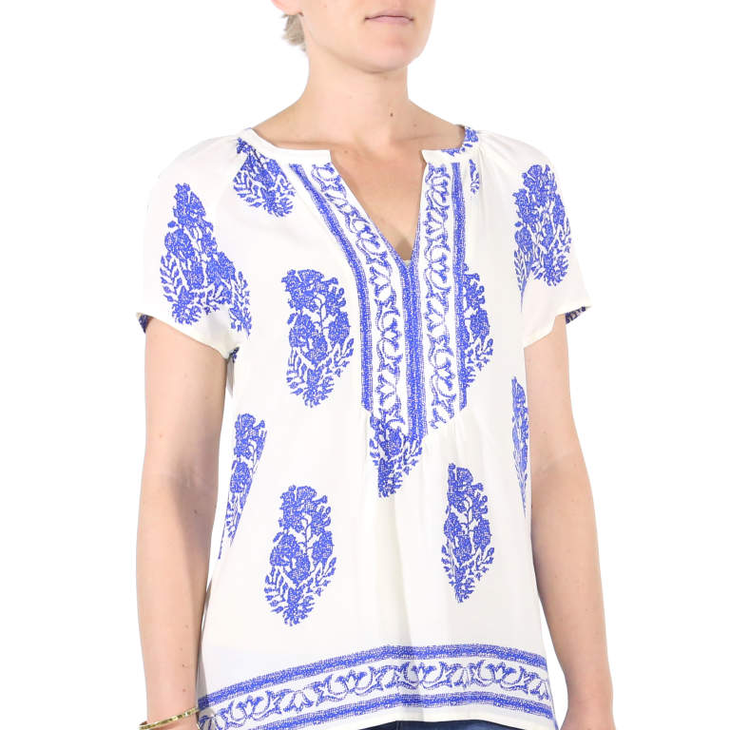
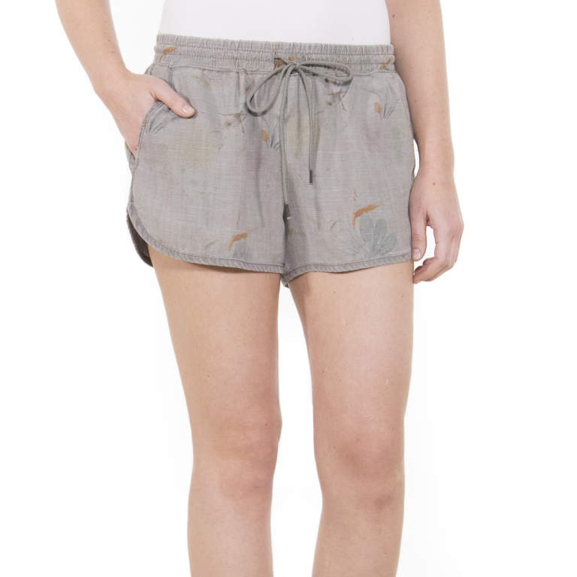
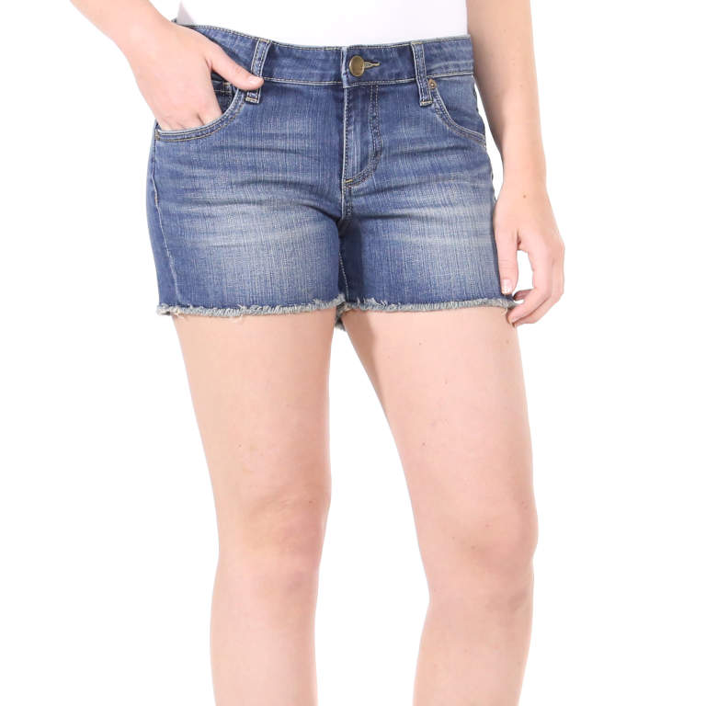
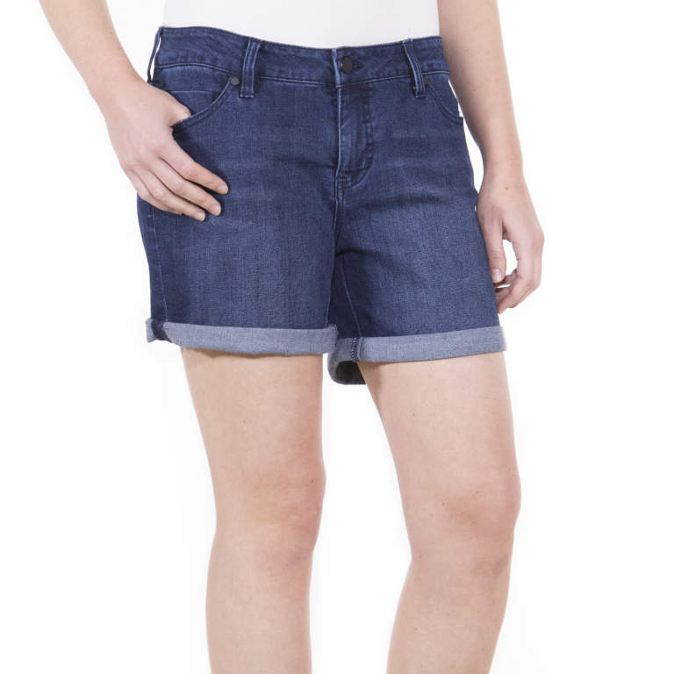
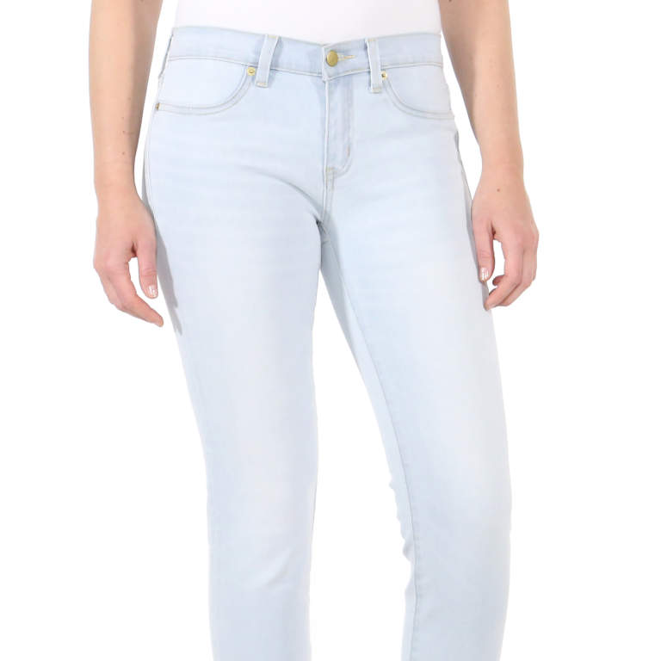
fulfilling request notes
I am interested in a cute pair of stylish but casual shorts, also light colored jeans like you showed in the stich fix picture with the Justine Split Neck Top also would be great.
top 5 styles

Slide 66
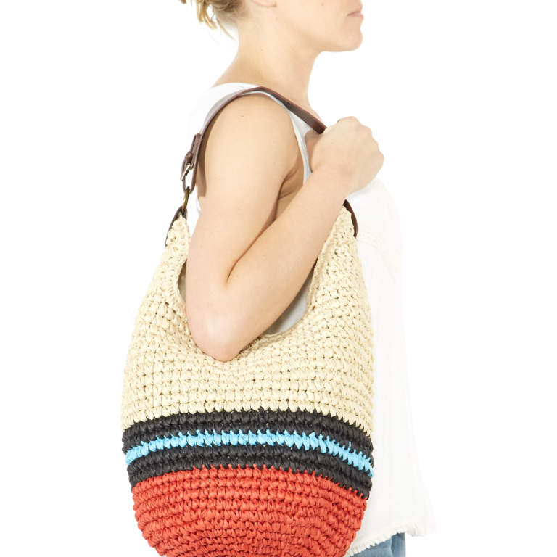
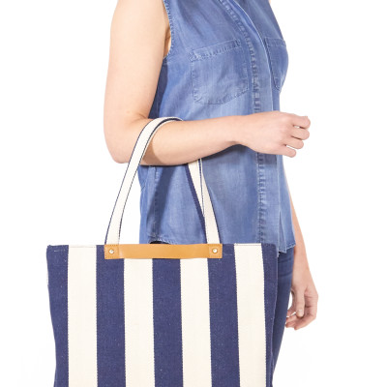
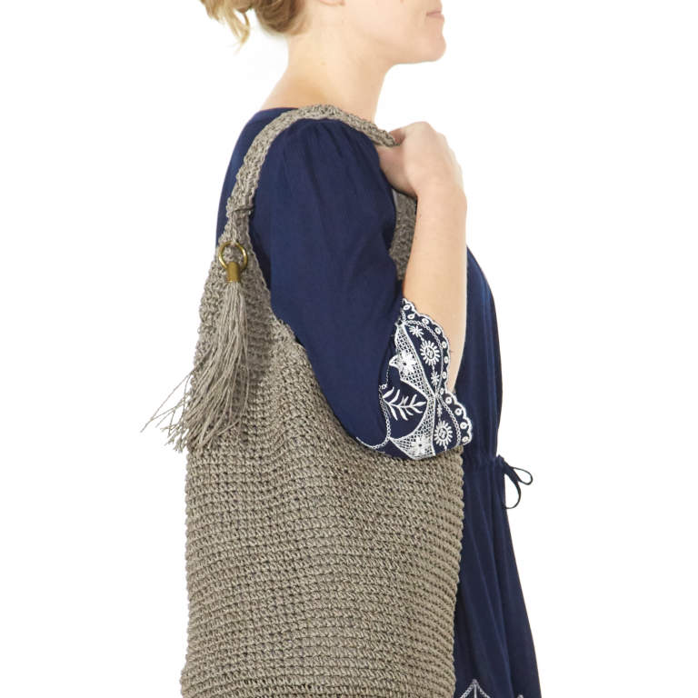
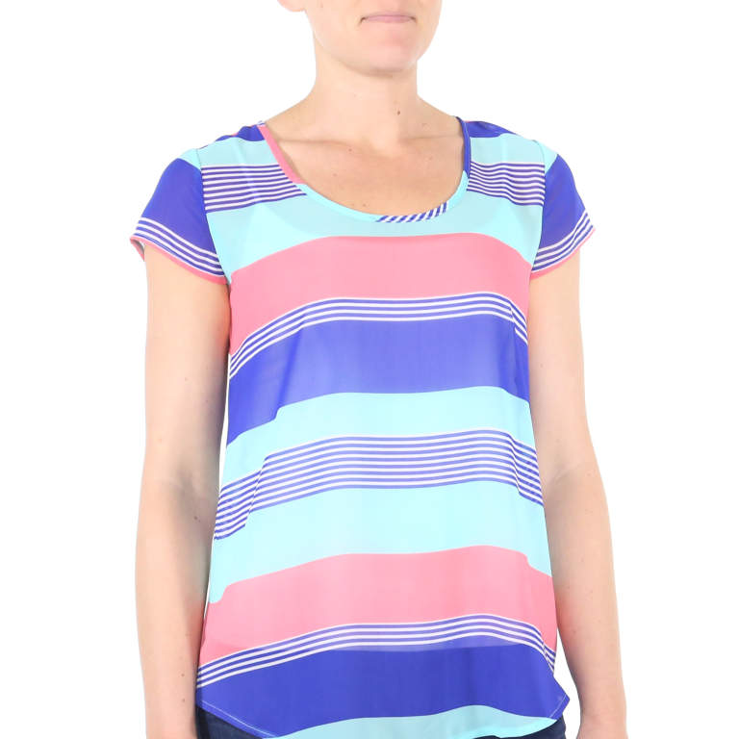
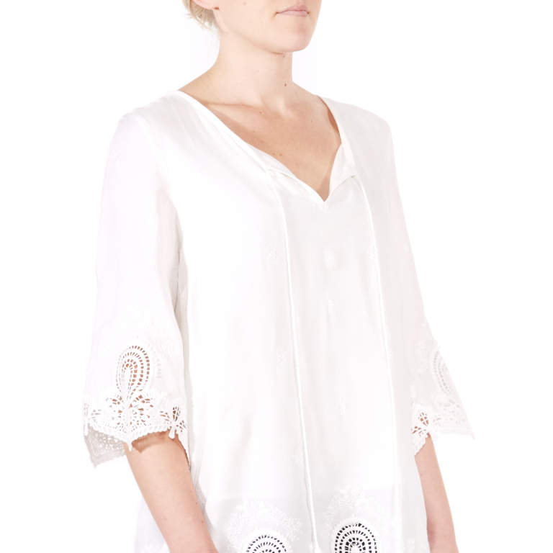
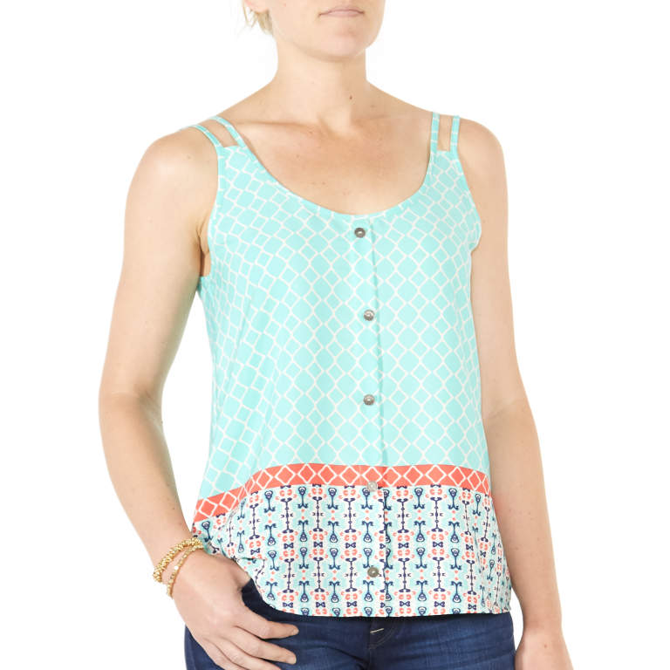
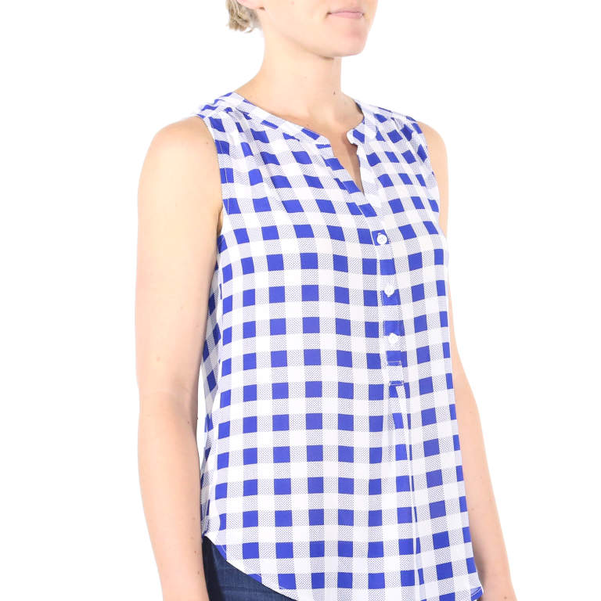
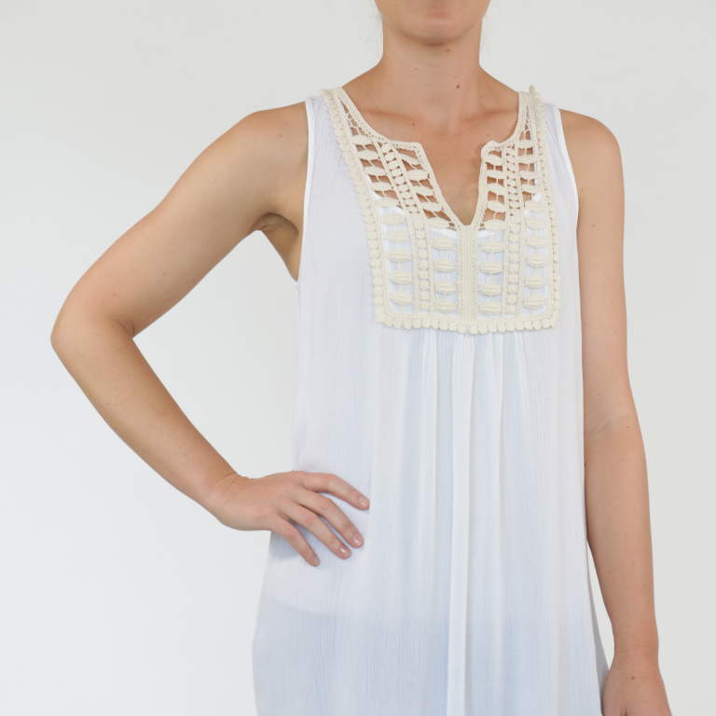
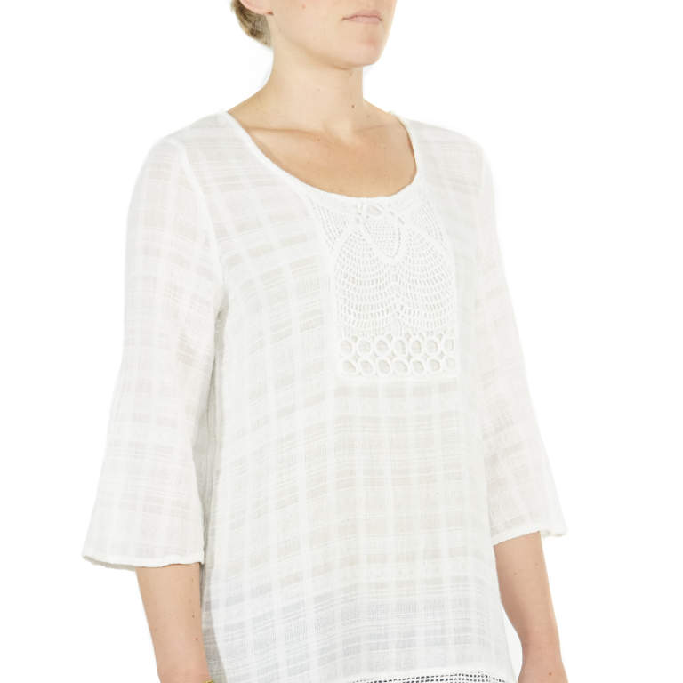
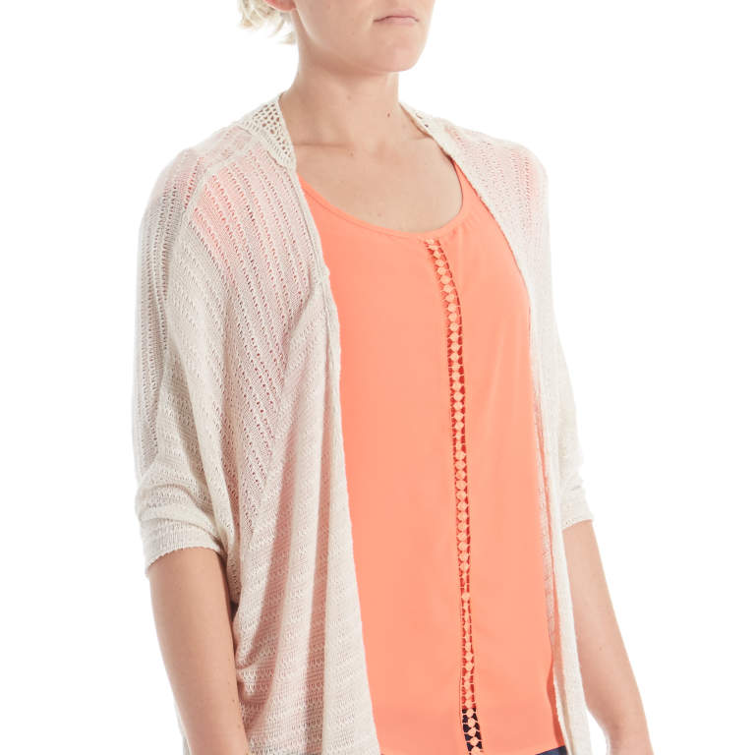
top 10 styles

Slide 67
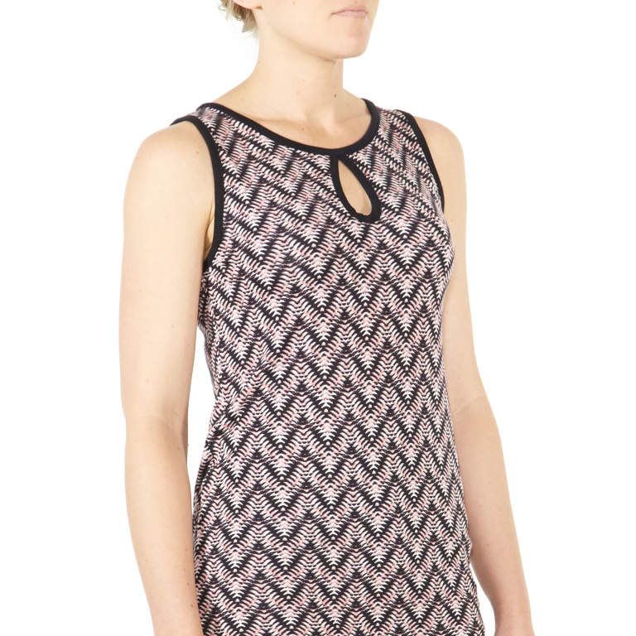
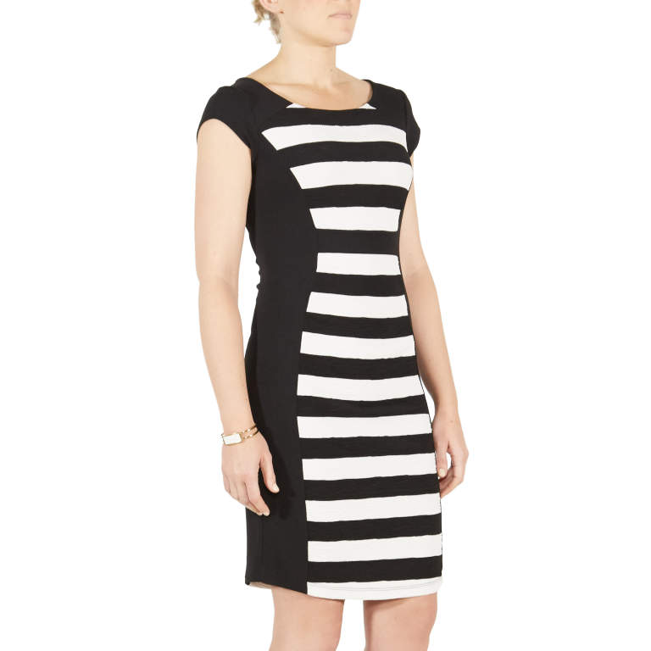
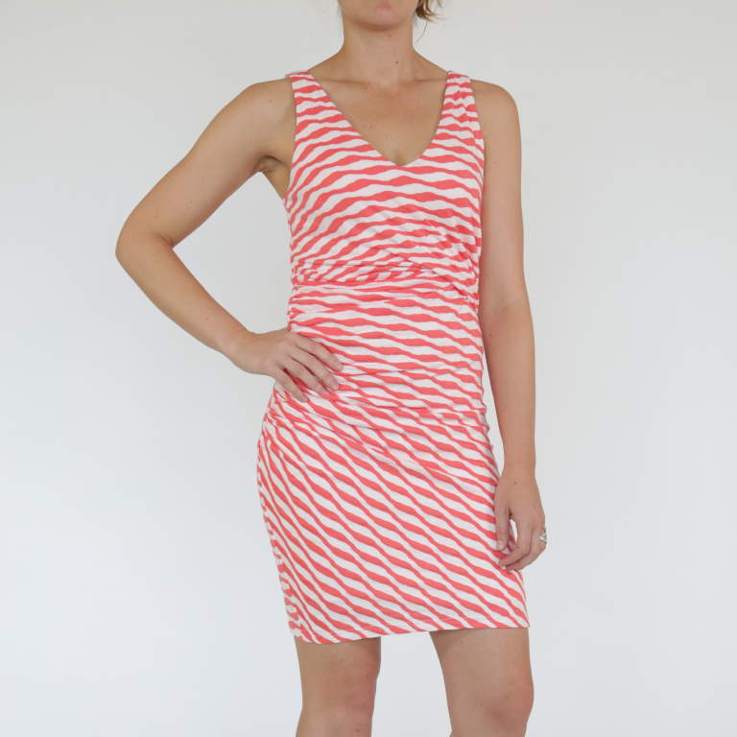
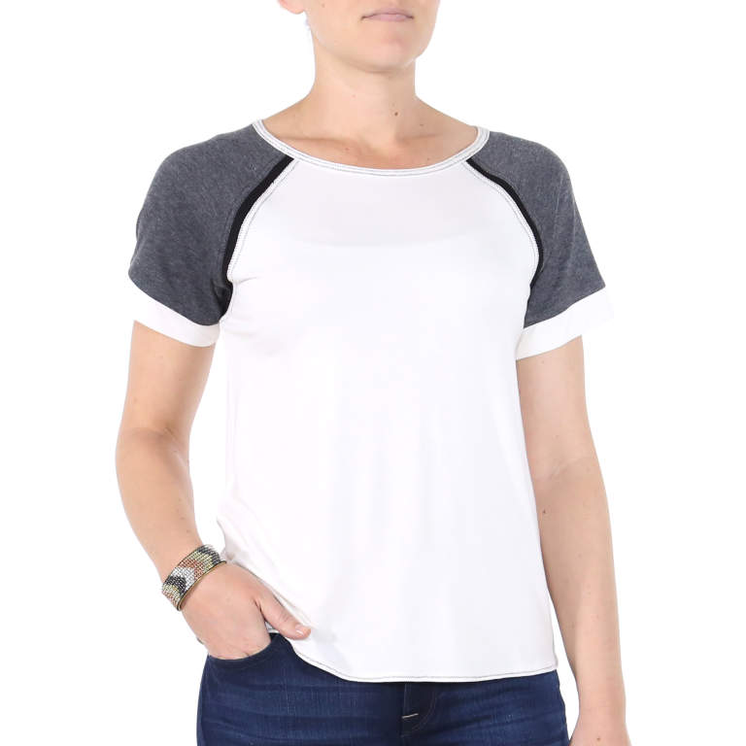






search
fitted:
loose:

Slide 68





bright florals

Slide 69





little black dress

Slide 70

attribute labels

Slide 71


Slide 72
what will Argyle consider soon?
inseam
location
client history
color
I am interested in a cute pair of stylish but casual shorts, also light colored jeans like you showed in the stich fix picture with the Justine Split Neck Top also would be great.

Slide 73
fin
your styling algorithms team
how the styling algorithm works
the future of algorithms
questions!?

